Slide 1
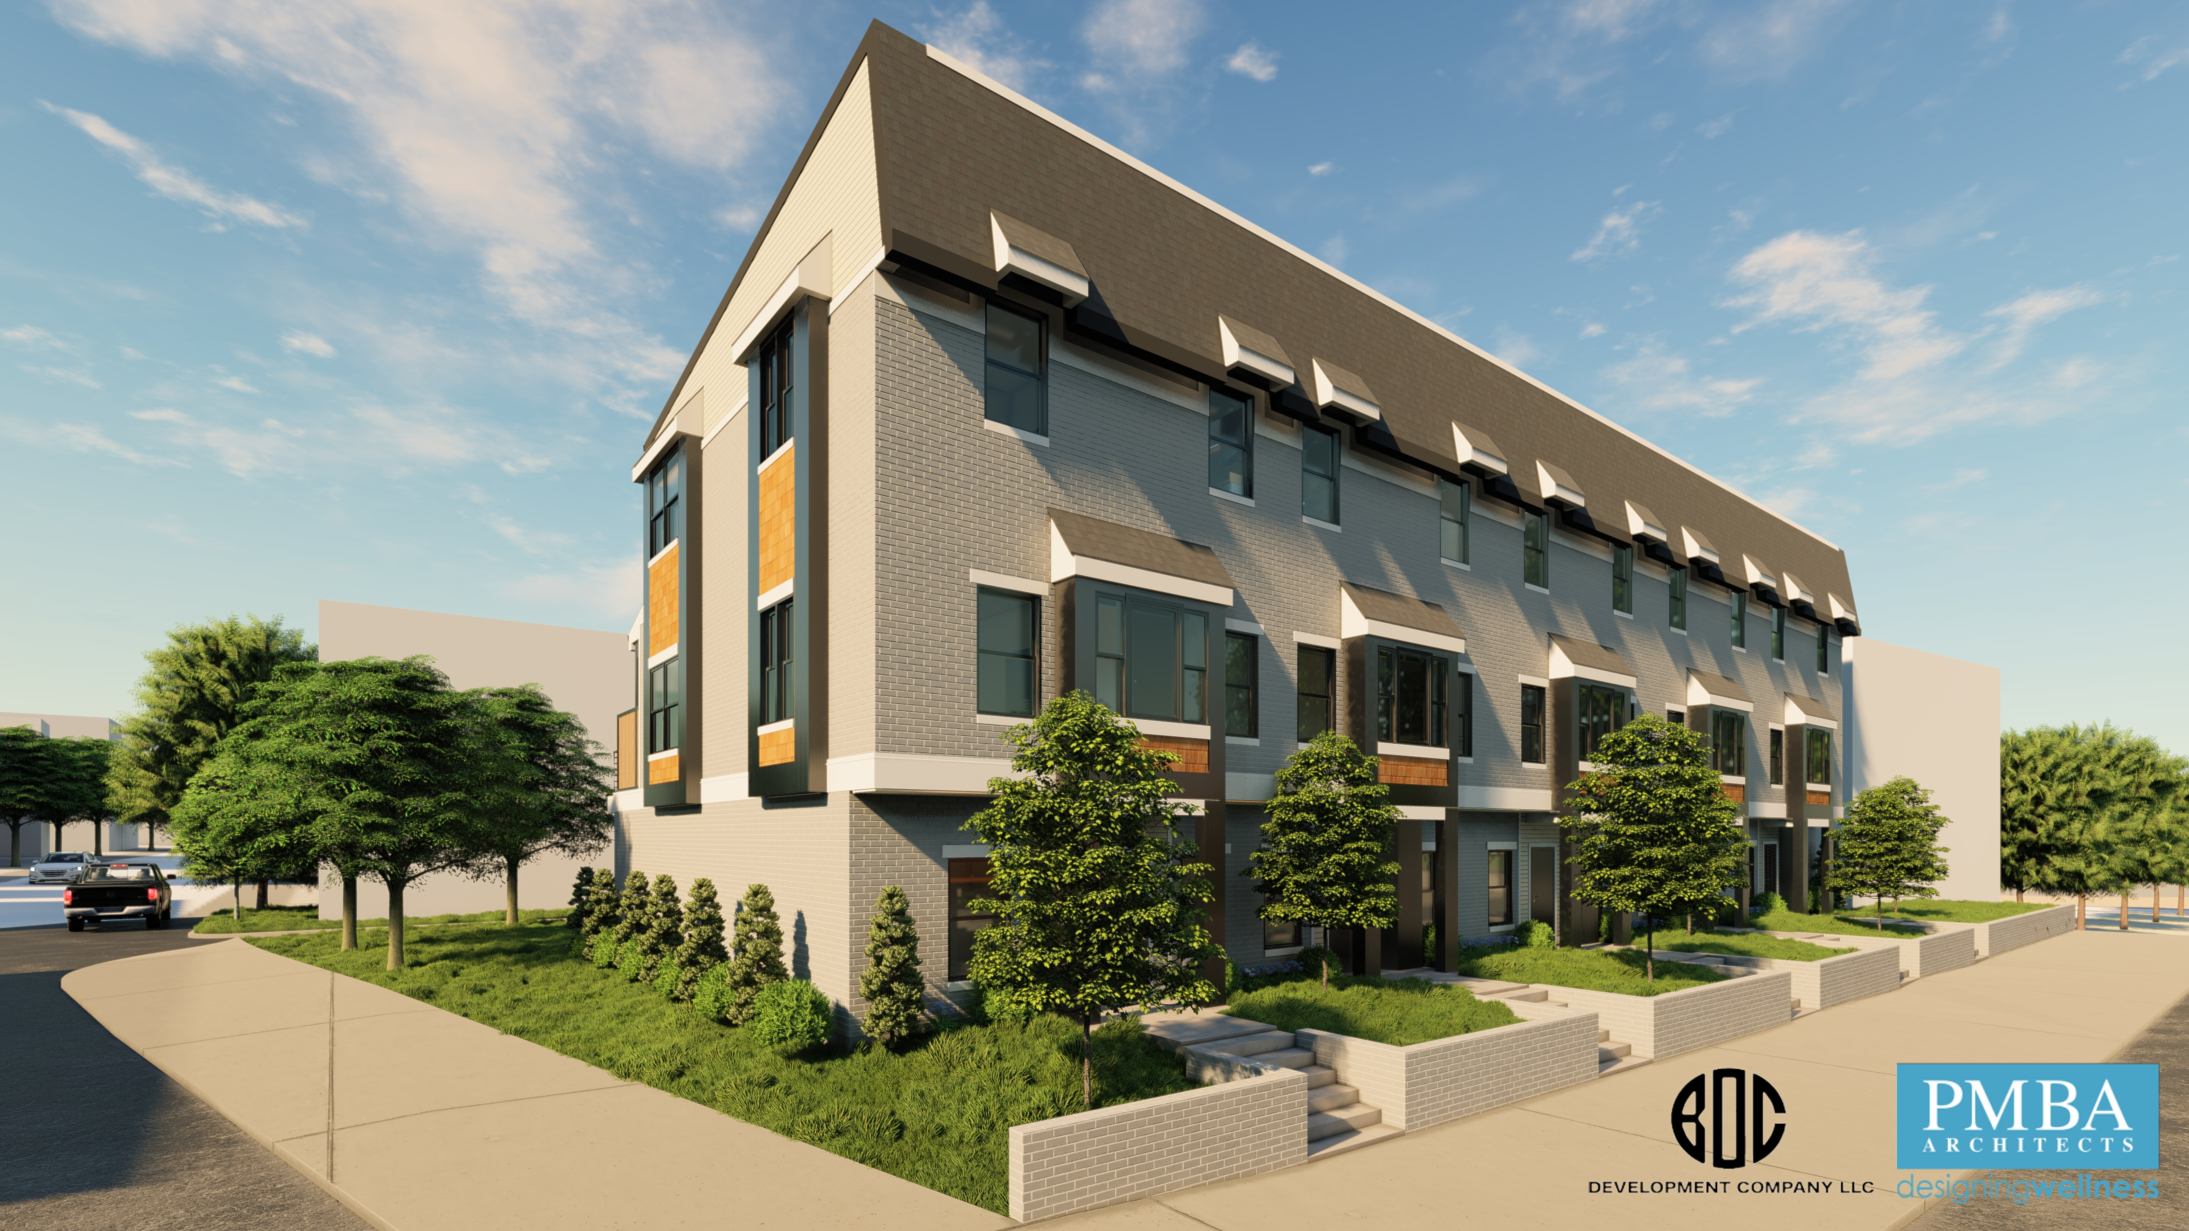
GCRA Market Update –Hamilton County
October 2023 Felicia Bell

Slide 2
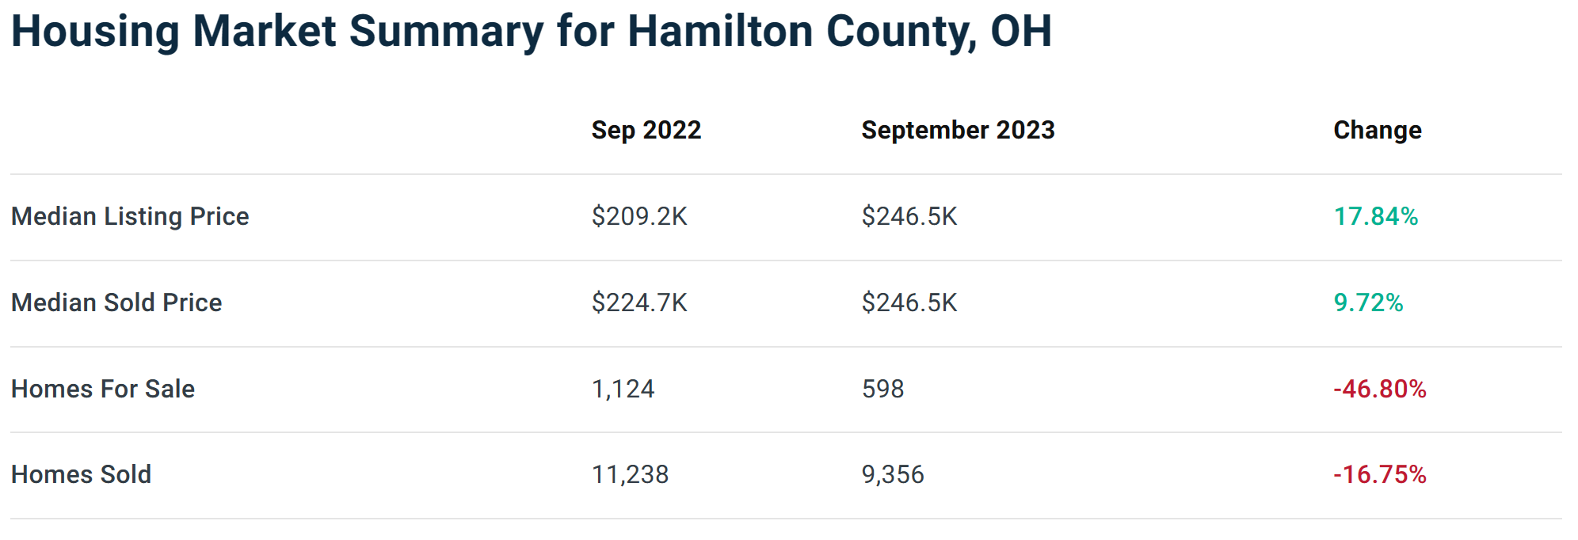

Slide 3
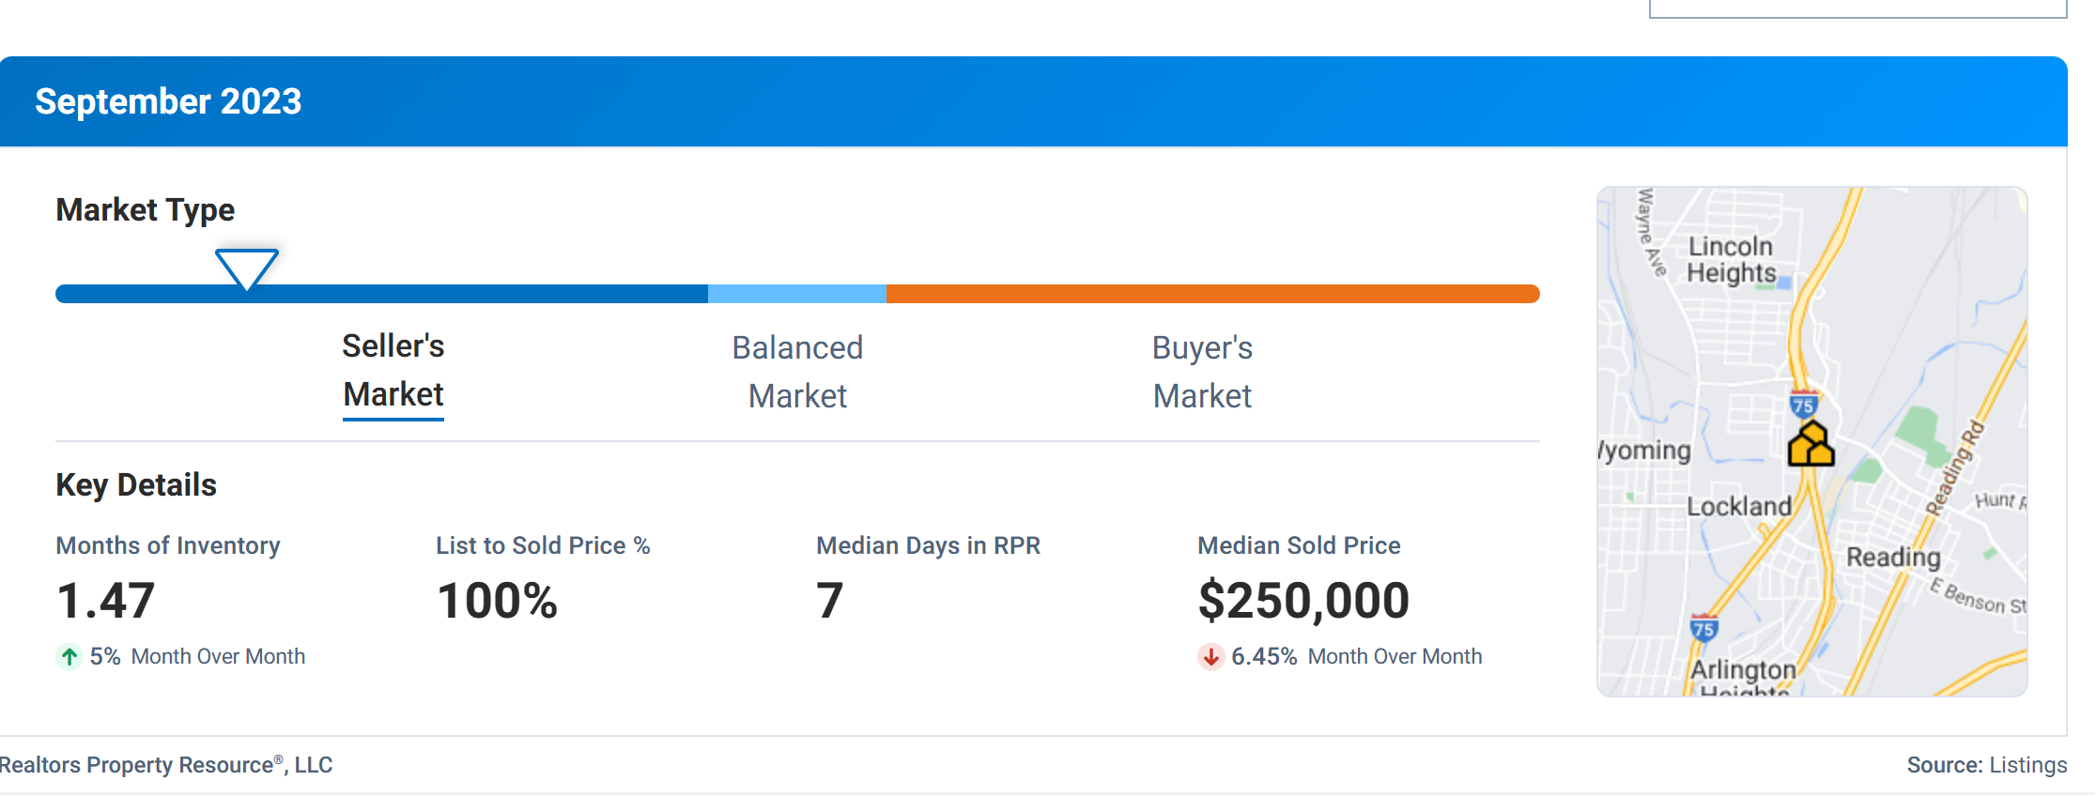
Hamilton County

Slide 4
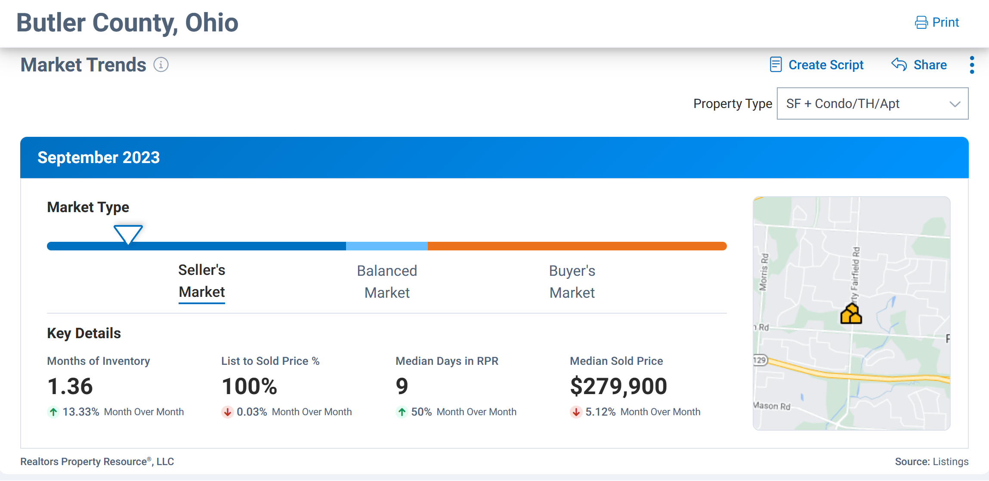

Slide 5
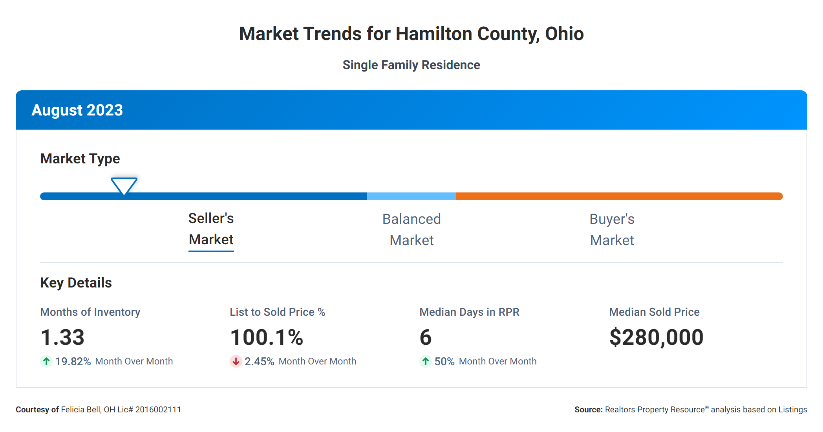

Slide 6
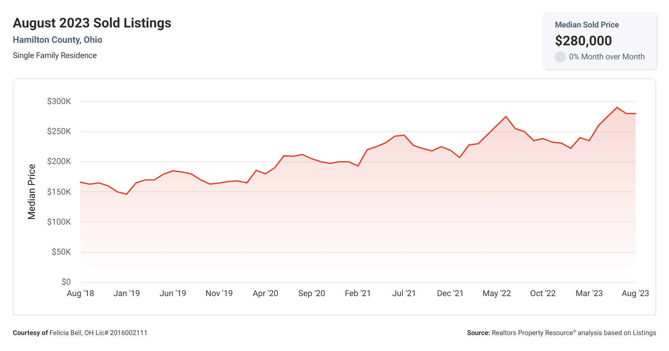

Slide 7
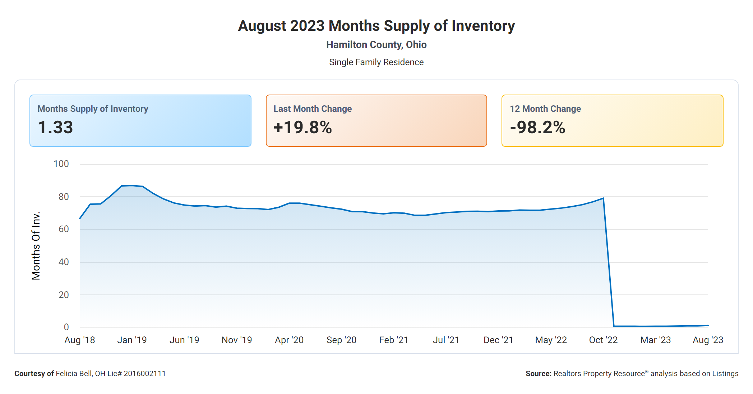

Slide 8
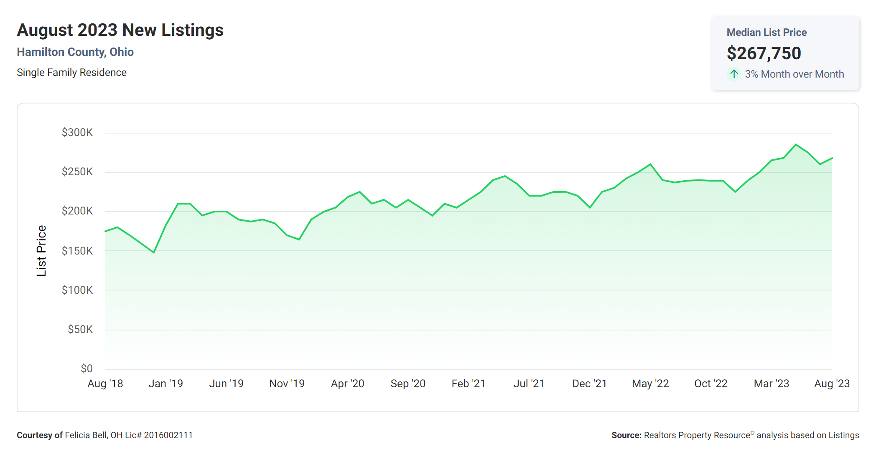

Slide 9
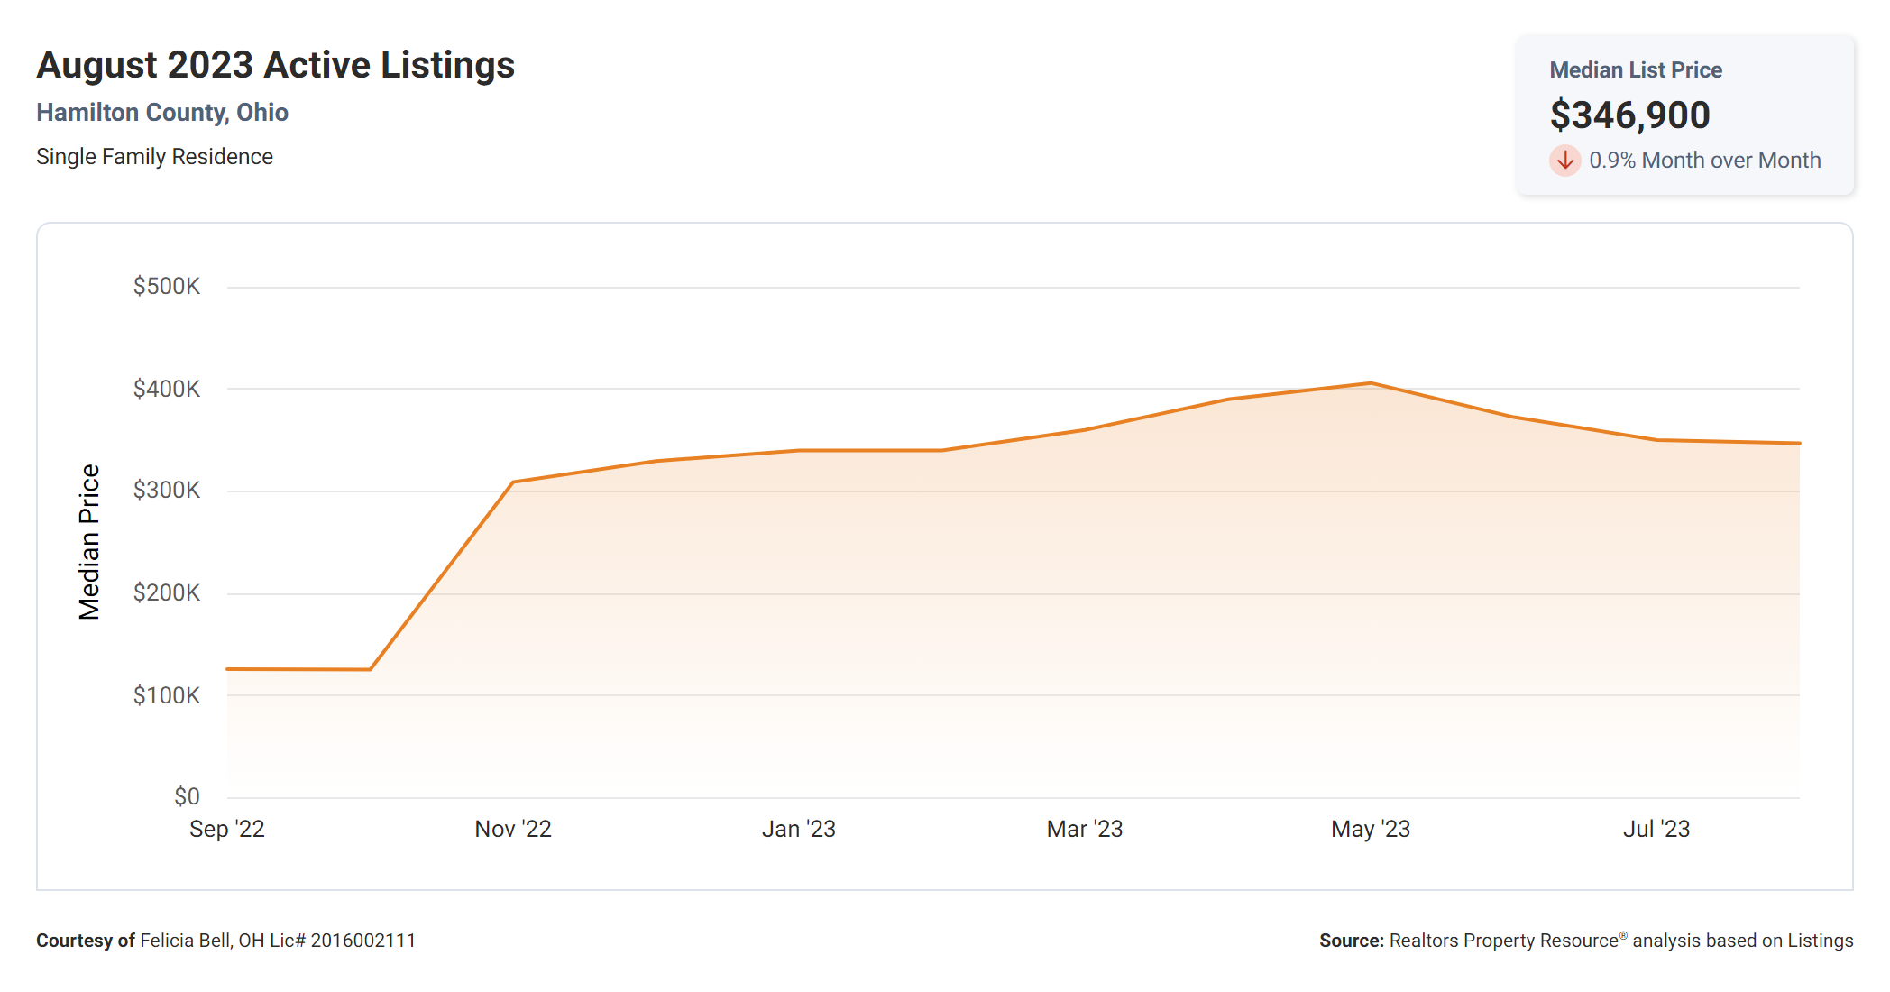

Slide 10
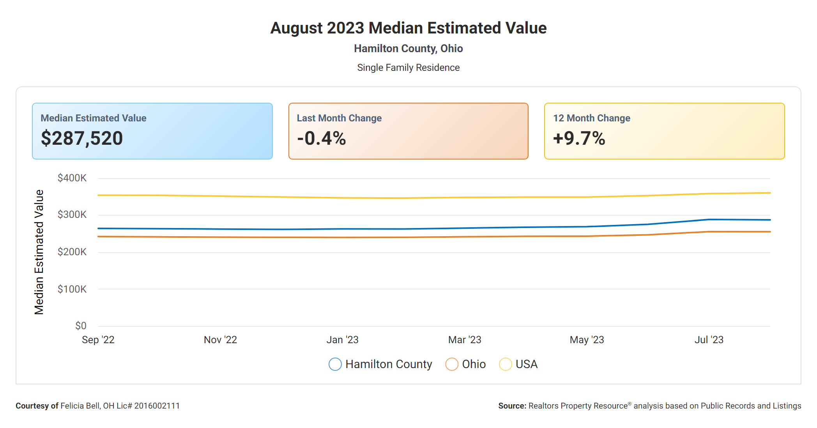

Slide 11
Realtor’s Property Resource (RPR)
Everyone who is a member of the NAR has access to RPR
RPR is a tool that provides data and reporting across the nation
RPR pulls data from public records and listed properties
RPR is a great to run reports and comps along side MLS or Perchwell
RPR continues to improve their capability to include AI technology interface, social media interface and reporting capability.
RPR has an overwhelming amount of information, so its important to pick and choose what you use and share.

Slide 12
Perchwell

